Slide 1
Topics
SVM
Kernel Function

Slide 2
SVM
Regression and Classification
Supervised or Unsupervised
Linear and Non-linear
Small to medium sized datasets

Slide 3
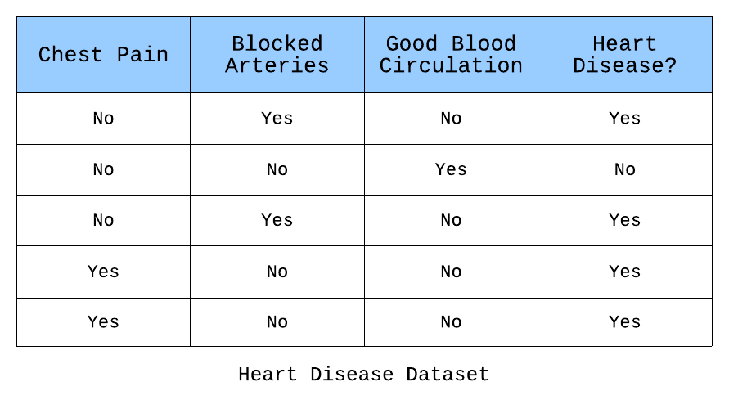
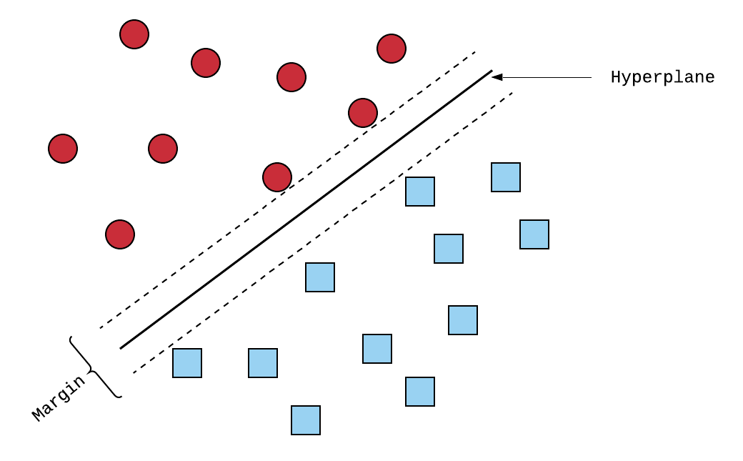
Line
Plane
Hyperplane

Slide 4
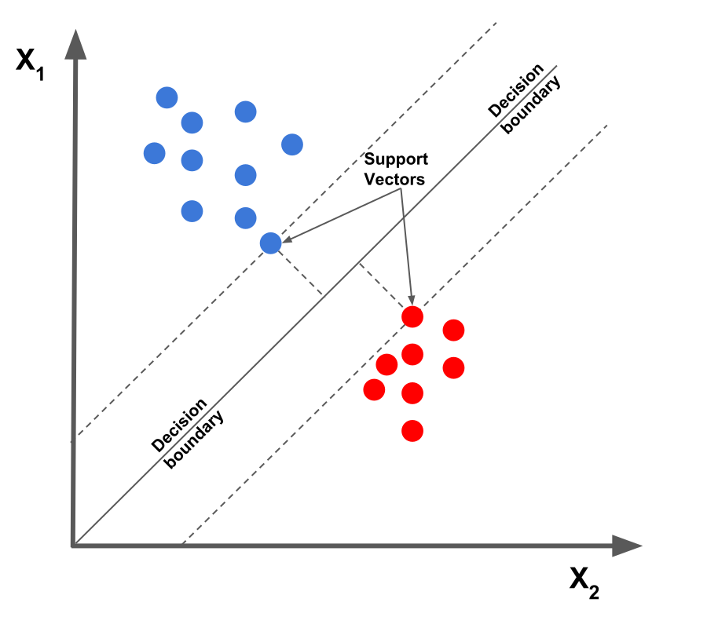
Support Vector?

Slide 5
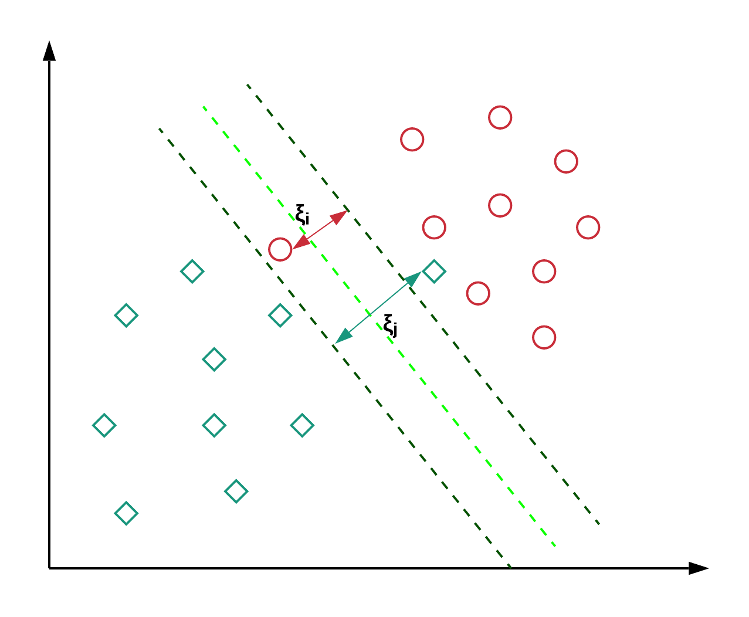
Outlier sensitivity
Hard margin
Margin violations = 0
Soft margin
Margin violations > 0

Slide 6
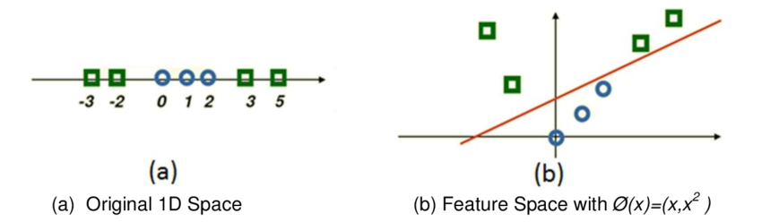
Non-Linear Classification
Adding polynomial features
Increases number of features
Training speed goes down

Slide 7
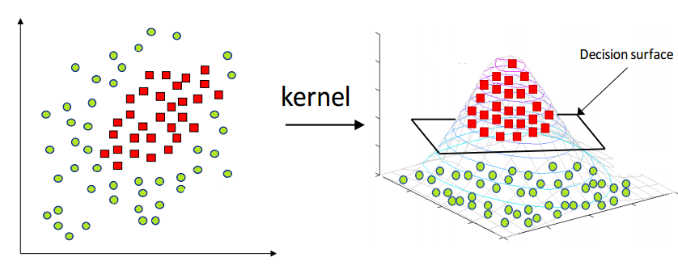
Non-Linear Classification
Kernel trick
Kernel = Function
Gaussian Radial Basis Function

